Slide 1


Exam AZ-801: Configuring Windows Server Hybrid Advanced Services, 2nd Ed
Tim Warner
Microsoft Certified Trainer and Microsoft MVP

Slide 2
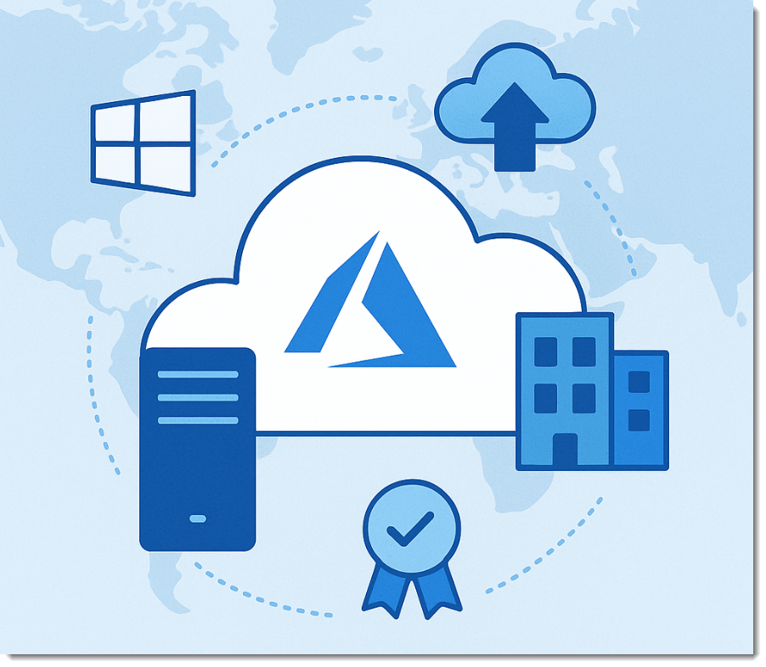
Lesson 7: Secure Storage with Encryption
7.1. Manage Windows BitLocker Drive Encryption
7.2. Enable storage encryption by using Azure Disk Encryption
7.3. Manage and recover encrypted volumes
7.4. Manage disk encryption keys for IaaS virtual machines
7.5 Configure File Server Resource Manager (FSRM) and Storage QoS for workload governance
Notes:
Image credit: Tim + ChatGPT Image Generation

Slide 3
7.1 Manage Windows BitLocker Drive Encryption

Slide 4
Protect disks with BitLocker Drive Encryption
Full volume encryption for OS and data drives
TPM, PIN, or USB key protectors secure keys
Network Unlock enables automatic startup for domain-joined systems
Group Policy standardizes BitLocker deployment across servers
Contoso escrows recovery keys in Active Directory
Notes:
Framing: Data on servers is the number one target. BitLocker is your first line of defense against stolen hardware or drives.
BitLocker provides full volume encryption for operating system and data drives. This means even if someone rips the drive out, the raw data is useless without keys. It’s an enterprise-grade control, not a convenience feature.
TPM, USB key, and password protectors secure encryption keys. Real-world best practice is TPM plus PIN for interactive use, and TPM-only for headless servers. Adding a second factor makes brute force impractical.
Network Unlock enables automatic decryption for domain-joined systems. This lets servers reboot automatically after patching, which is critical in data centers. The catch: it only works on wired networks and needs supporting infrastructure.
Group Policy settings standardize BitLocker configuration across Contoso servers. Don’t trust individual admins to configure correctly; enforce encryption method and recovery options centrally. This ensures consistency across hundreds of machines.
Recovery password escrow provides administrative key recovery. Always escrow into AD DS or Azure AD; text files or spreadsheets won’t pass an audit and can cause outages.
Exam Tip: If you see a scenario about stolen server disks in a branch office, the correct answer is to use BitLocker with recovery key escrow in Active Directory.

Slide 5
7.2 Enable storage encryption by using Azure Disk Encryption

Slide 6
Encrypt Azure VMs with Azure Disk Encryption
Integrates BitLocker (Windows) and DM-Crypt (Linux) with Azure Key Vault
Supports customer-managed keys for compliance requirements
Single-pass encryption available during VM deployment
Encryption at host secures data before hitting physical disks
Fabrikam protects regulated workloads with Key Vault integration
Notes:
Framing: In Azure, you never just “turn on” BitLocker in the guest. You use Azure Disk Encryption so keys and lifecycle are tied to Azure Key Vault.
Azure Disk Encryption integrates BitLocker with Azure Key Vault. This ensures encryption keys are safeguarded in a managed service, not left floating inside the VM. It also means key recovery is seamless during restore operations.
Customer-managed keys provide additional control over encryption keys. This is often mandatory for regulated industries—finance, healthcare, government. Customers can rotate or revoke keys when compliance requires.
Single-pass encryption enables encryption during VM deployment. It’s faster and cleaner than older double-pass models. Use it by default so workloads start encrypted from day one.
Encryption at host protects data on physical server hardware. This encrypts before it ever touches the storage layer. It’s a solid defense-in-depth move and closes off attack paths against infrastructure admins.
Cross-region backup maintains encrypted data protection. This means you can fail over and still retain encryption end-to-end, which is essential for disaster recovery planning.
Exam Tip: Watch out for scenarios where admins try to configure BitLocker directly inside the VM with Group Policy. The correct hybrid cloud solution is Azure Disk Encryption with Key Vault integration.

Slide 7
7.3 Manage and recover encrypted volumes

Slide 8
Ensure access with recovery and management tools
BitLocker recovery passwords enable emergency access
Active Directory stores recovery info for centralized management
PowerShell automates recovery and management tasks
Suspend/resume modes support maintenance operations
Tailwind Traders uses self-service recovery to reduce helpdesk load
Notes:
Framing: Encryption is critical—but so is managing that encryption. If you can't recover encrypted drives quickly, you've locked your own organization out of critical data.
BitLocker recovery passwords enable emergency access. These recovery keys are your emergency exit—never deploy encryption without a reliable key recovery plan. They're your lifeline when hardware or firmware changes occur.
Active Directory stores recovery info for centralized management. Storing BitLocker keys in Active Directory means no spreadsheets or sticky notes. This keeps recovery auditable, standardized, and ready when needed.
PowerShell automates recovery and management tasks. Use commands like Suspend-BitLocker and Resume-BitLocker to automate routine maintenance. This prevents servers from booting into recovery mode during updates.
Suspend/resume modes support maintenance operations. Before firmware upgrades or major patches, suspend BitLocker. After changes complete successfully, resume encryption. It’s safe, fast, and keeps the server secure.
Tailwind Traders uses self-service recovery to reduce helpdesk load. Users retrieve their own BitLocker recovery keys securely through self-service portals. This slashes ticket volumes, frees up support resources, and accelerates recovery.
Exam Tip: On AZ-801, watch for scenarios involving lost or replaced TPM modules or failed firmware updates—your answer is always BitLocker recovery via Active Directory escrow or a self-service portal.

Slide 9
7.4 Manage disk encryption keys for IaaS virtual machines

Slide 10
Control and protect encryption keys at scale
Azure Key Vault secures VM encryption keys
Role-based access controls restrict who can retrieve keys
Key rotation policies enforce cryptographic hygiene
HSM-backed storage provides extra protection
Adventure Works implements versioning for key lifecycle management
Notes:
Framing: Managing encryption at enterprise scale is about more than keys; it’s about governance. Lose control of keys, and your encrypted data is useless or compromised.
Azure Key Vault secures VM encryption keys. Azure Key Vault centralizes and protects your encryption keys. This ensures consistent policy enforcement, auditing, and simplifies key recovery during disaster scenarios.
Role-based access controls restrict who can retrieve keys. RBAC ensures only authorized users or applications can access encryption keys. Separate roles clearly—VM admins shouldn't automatically manage cryptographic keys.
Key rotation policies enforce cryptographic hygiene. Enforce regular key rotations to satisfy regulatory compliance, avoid key reuse vulnerabilities, and maintain high security standards across your hybrid environments.
HSM-backed storage provides extra protection. Use Hardware Security Modules (HSM) in Key Vault to satisfy FIPS compliance and add an extra hardware-protected security boundary around your most sensitive keys.
Adventure Works implements versioning for key lifecycle management. Key versioning is essential for controlled rollbacks. Maintain old key versions until you’re absolutely certain all workloads decrypt reliably with newer keys.
Exam Tip: For AZ-801 scenarios involving encryption key management in Azure, always choose Azure Key Vault with customer-managed keys and proper RBAC controls—never local-only BitLocker management within Azure VMs.

Slide 11
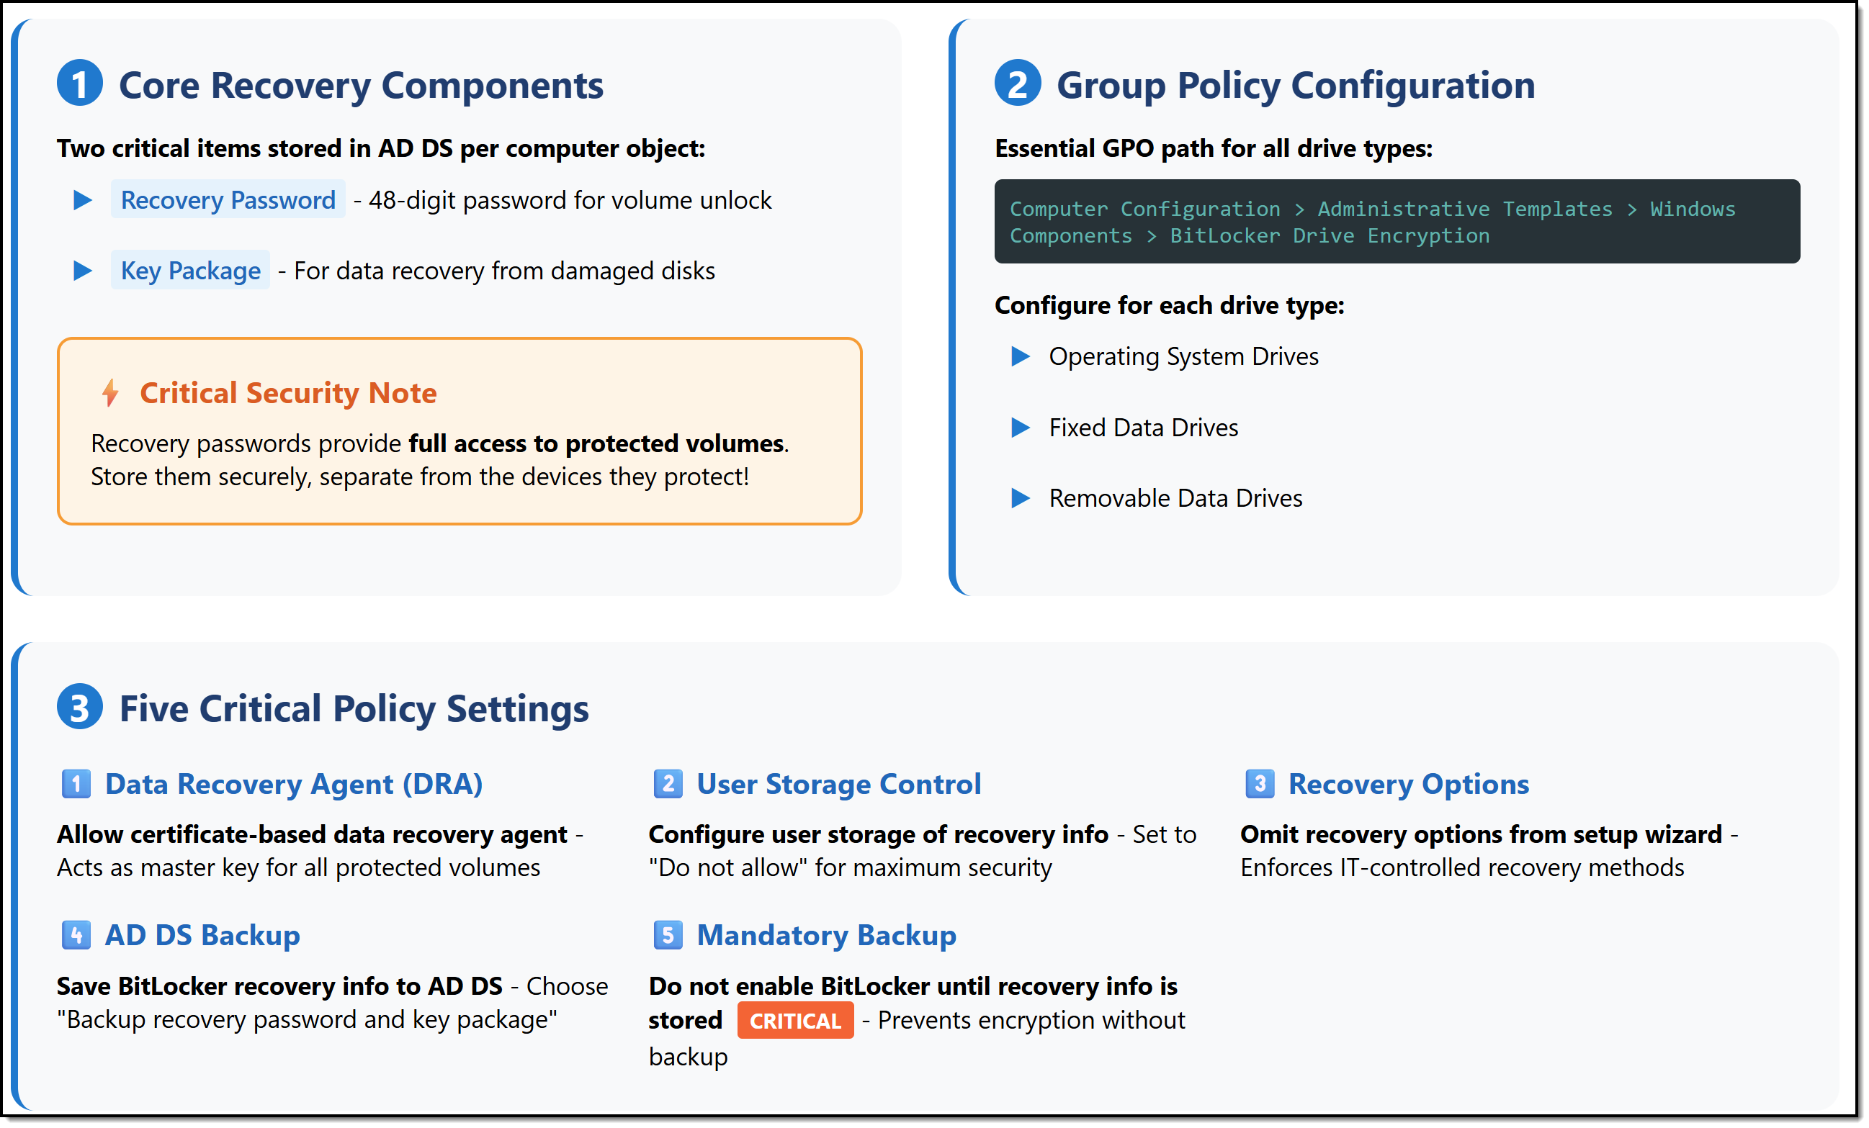
BitLocker key management best practices
Notes:
Image credit: Tim + Claude AI
BitLocker is critical, but losing recovery keys will cause a crisis. Follow these best practices to keep BitLocker manageable, secure, and audit-friendly at scale.
Core Recovery Components: BitLocker stores two things in Active Directory per protected machine: the Recovery Password, a 48-digit key you’ll need when things break, and the Key Package, a special file for recovering data if your drive gets corrupted. Protect these—anyone with these keys owns your encrypted volumes.
Group Policy Configuration: Standardize BitLocker using Group Policy under Computer Configuration → Administrative Templates → Windows Components → BitLocker Drive Encryption. Configure encryption requirements separately for operating system drives, fixed data drives, and removable drives. Don't let admins freelance these settings—always use policy.
Five Critical Policy Settings:
Set up a Data Recovery Agent (DRA) as your emergency master key for all protected volumes.
For User Storage Control, block end users from storing recovery information independently—keep it centralized.
In Recovery Options, omit recovery choices from setup wizards to enforce IT-approved recovery methods only.
Enable AD DS Backup to always save both the BitLocker recovery password and the key package into Active Directory.
Use Mandatory Backup—don’t allow BitLocker to activate until recovery keys are safely escrowed. This avoids disasters later.
Exam Tip: AZ-801 scenarios will often test your knowledge of BitLocker recovery and management best practices. Remember, centralized key management and strict Group Policy enforcement are always correct answers.

Slide 12
7.5 Configure File Server Resource Manager (FSRM) and Storage QoS for workload governance

Slide 13
Govern workloads with FSRM and Storage QoS
FSRM enforces quotas and file screens on file servers
Storage QoS manages IOPS allocations per VM
File classification enables policy-driven storage management
File management tasks automate archival or cleanup jobs
Fabrikam uses Storage QoS to prevent “noisy neighbor” VMs
Notes:
Framing: Encryption keeps data safe, but it doesn't manage usage or performance. Storage governance ensures fair and efficient use of storage across workloads.
FSRM enforces quotas and file screens on file servers. Use quotas to proactively control storage growth. File screens block unauthorized file types like ISOs, PSTs, or MP4s to keep storage clean and compliant.
Storage QoS manages IOPS allocations per VM. This prevents one VM or workload from consuming all available storage performance. You can guarantee minimum IOPS to critical workloads while limiting others.
File classification enables policy-driven storage management. Automatically tag files based on content, type, or compliance requirement. For example, sensitive data like customer records can automatically trigger encryption or secure archiving.
File management tasks automate archival or cleanup jobs. Use scheduled tasks to archive old files, clean up stale data, or enforce retention policies automatically. This reduces manual intervention and improves consistency.
Fabrikam uses Storage QoS to prevent "noisy neighbor" VMs. "Noisy neighbors" are workloads that consume excessive IOPS, slowing down everyone else. Storage QoS ensures fair performance for all VMs and workloads.
Exam Tip: On AZ-801, watch out for scenarios involving poor storage performance or uncontrolled growth. The answer will often involve FSRM quotas, file screens, or Storage QoS for effective storage governance.

Slide 14
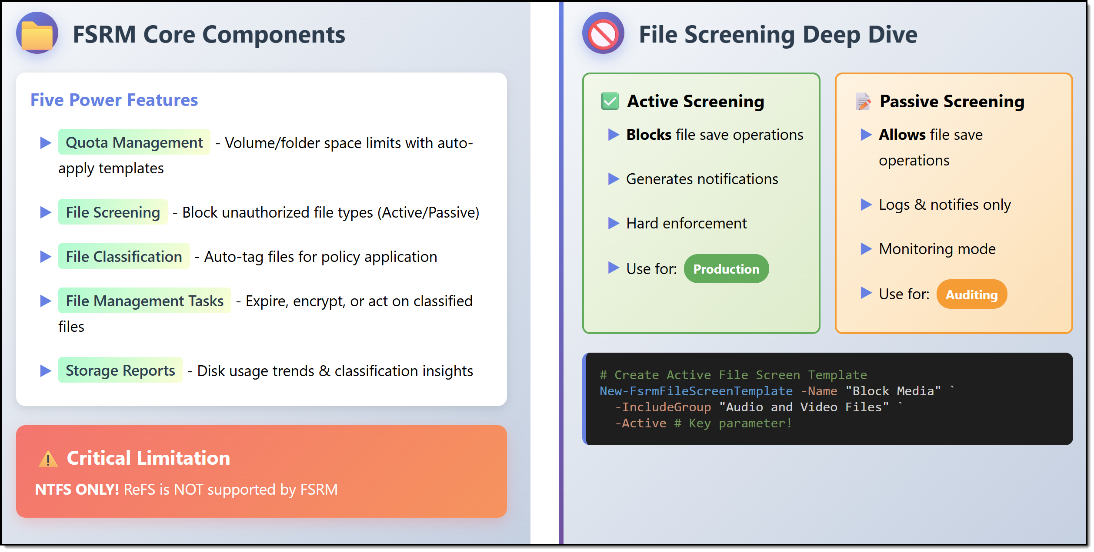
FSRM core components and file screening
Notes:
Image credit: Tim + Claude AI
Framing (1 sentence): FSRM is your Swiss Army knife for controlling file servers — it gives you quotas, rules, screening, classification and reports in one console.
FSRM Core Components (left side):
Quota Management: set folder or volume space limits using templates, enforce hard or soft caps.
File Screening: block or monitor unwanted file types (e.g. no MP3s, no EXEs) via active or passive screening.
File Classification: auto-tag files based on content or properties so policies can act on them.
File Management Tasks: trigger actions (expire, encrypt, move) on files based on classification, age, or location.
Storage Reports: trend usage, see classification breakdowns, generate alerts and reports.
File Screening Deep Dive (right side):
Active Screening: blocks save operations outright, enforces rules, and sends notifications — use this in production.
Passive Screening: allows saves to proceed but logs attempts and notifies — useful for auditing or trial phases.
Use templates to standardize screens (e.g. “Block Media Files” with -Active) and exceptions for subfolders.
Critical Note / Limitation: FSRM only works with NTFS volumes — ReFS is not supported. Microsoft Learn+1
Exam Tip: Know scenarios where you choose active vs passive file screening. Also, understand how quotas + screens + classification interact in FSRM — exam questions commonly test trade-offs (e.g. “you want to alert first, then enforce later”).

Slide 15
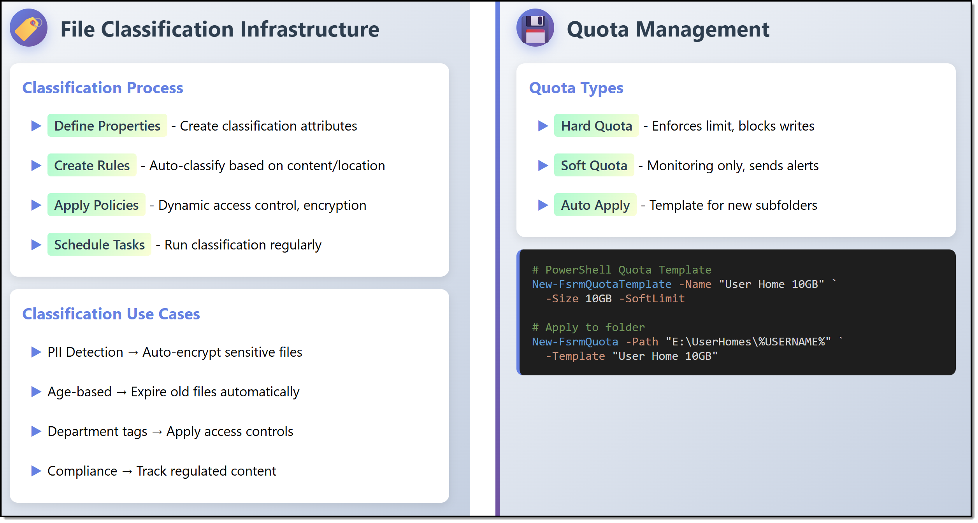
FCI and quota management
Notes:
Image credit: Tim + Claude AI
Framing (1 sentence): Encryption locks down disks, but governance demands we classify and constrain what gets stored and how much.
File Classification Infrastructure (FCI): We begin with FCI — define file properties and classification attributes, build rules to auto-tag based on content or location, and then apply policies such as dynamic access control, encryption, or expiration. You can schedule classification tasks to run regularly to keep your environment tagged.
Quota Management: On the quota side, using FSRM you create hard quotas that block writes, or soft quotas that just alert. You can auto-apply quotas to new subfolders via templates, and generate reports or notifications when thresholds are crossed. Microsoft Learn+1
Azure analog / modern alternative: In Azure, you won’t find a direct FSRM equivalent, but governance shifts toward Microsoft Purview for classification, labeling, and scanning of Azure Files / storage accounts. Purview lets you scan, classify, and apply sensitivity labels across your data estate. Microsoft Learn+1
Exam tip: For AZ-801, make sure you can compare FCI + FSRM features (hard vs soft quotas, auto apply, scheduled tasks) with how cloud-based governance (Purview scans, sensitivity labels) handles classification and data policies. Be ready to map on-prem tools to cloud equivalents.

Slide 16
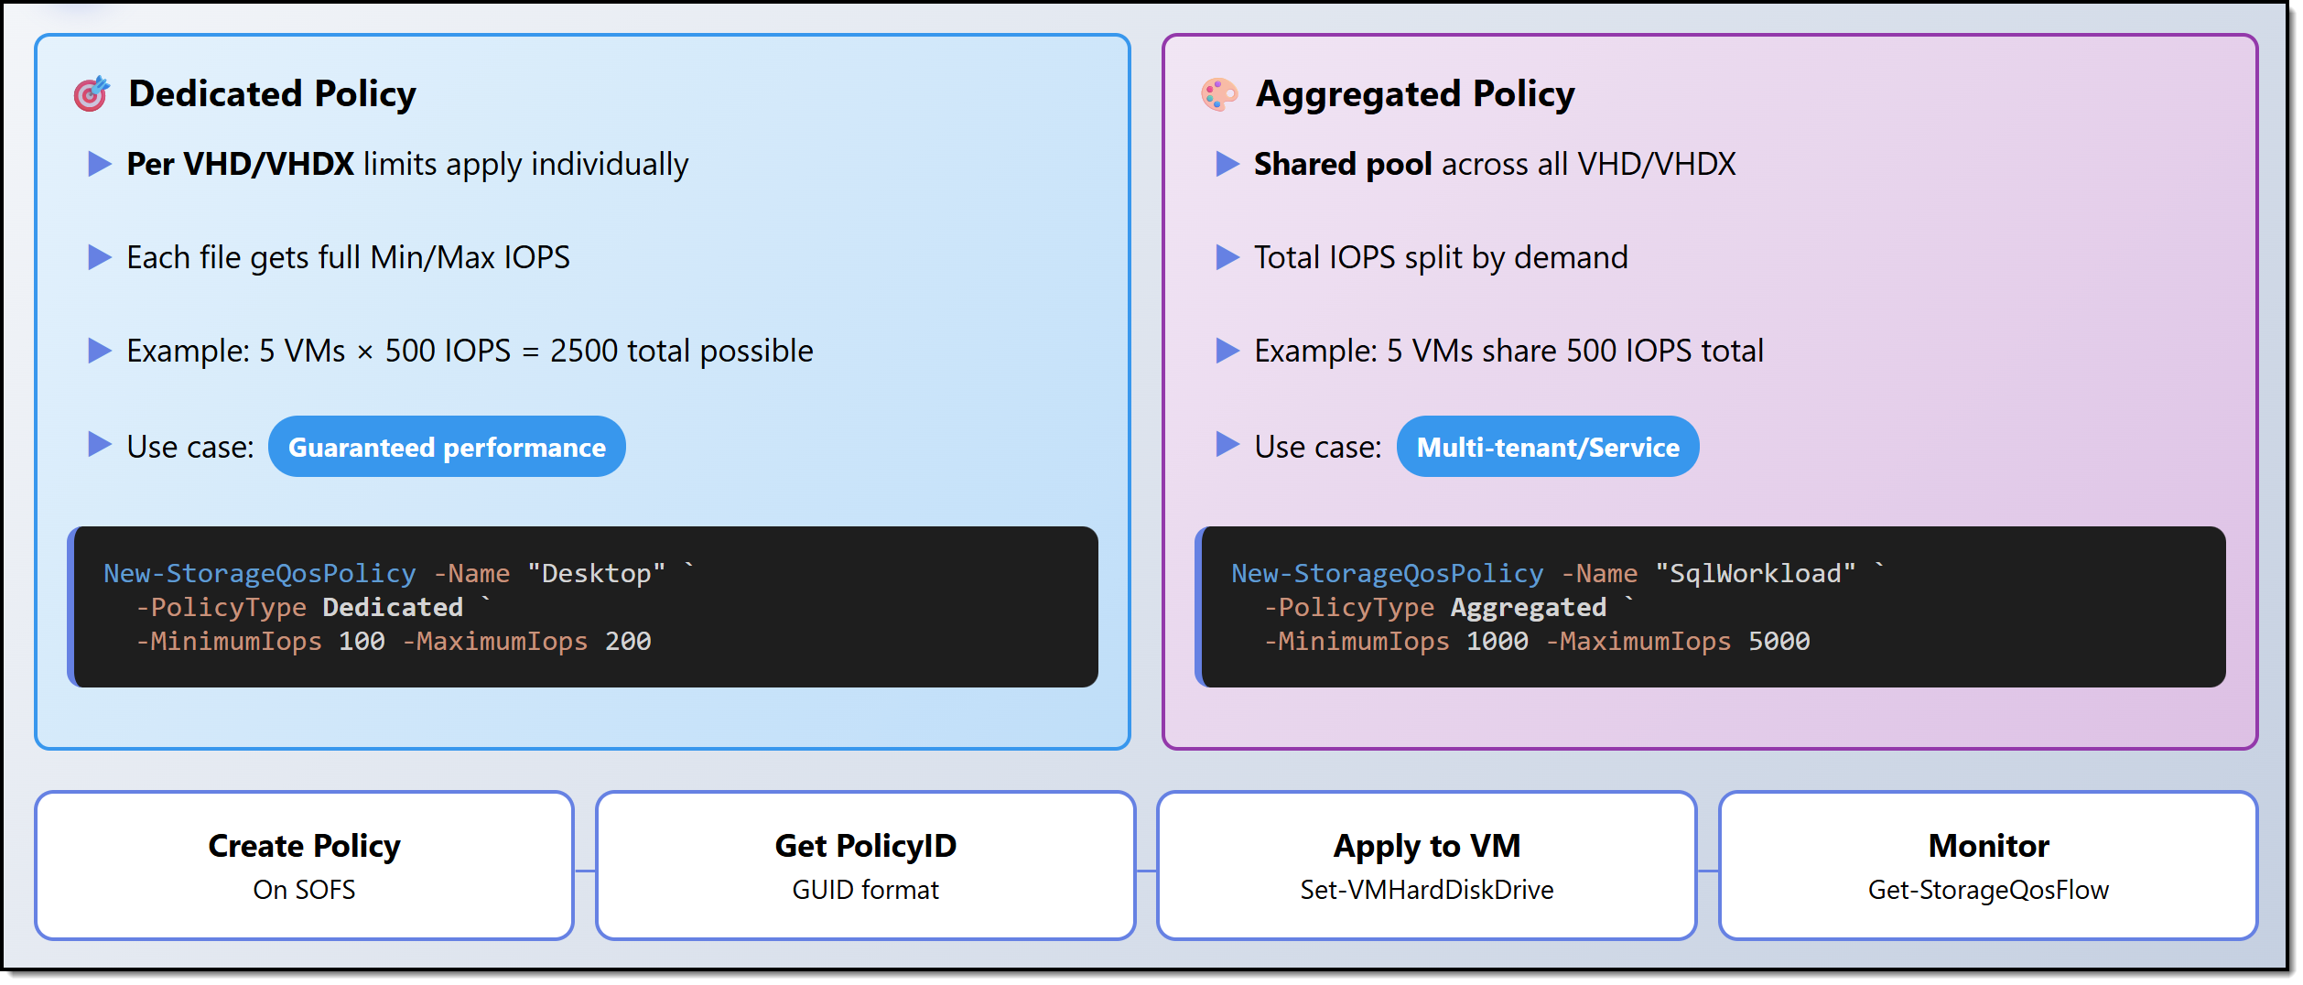
Storage QoS policy types
Notes:
Image credit: Tim + Claude AI
Opening / overall frame (≈10 sec): “We’ve already covered classification, quotas, and file screening — but one missing piece in storage governance is performance control. This slide shows how Storage QoS policies let you shape I/O behavior, not just block or alert.”
Left side — Dedicated policy (≈20 sec): “On the left panel, the Dedicated policy model gives each VHD/VHDX its own minimum and maximum IOPS allocation. You’re guaranteeing per-virtual-disk performance. For example, five VMs each with 500 IOPS yields up to 2,500 IOPS total. Use this when you want predictability and strict SLAs for each workload.”
Right side — Aggregated policy (≈20 sec): “In contrast, the Aggregated policy (right side) pools IOPS across all assigned disks. Instead of giving each disk a fixed slice, the entire group shares a performance budget. So five VMs might share a total of 500 IOPS, splitting dynamically based on demand. It’s ideal in multi-tenant or service models where you want flexibility over rigid guarantees.”
Bottom / mechanism & exam tip (≈15 sec): “To implement, you use New-StorageQoSPolicy in PowerShell, specifying PolicyType (Dedicated or Aggregated) plus minimum & maximum IOPS. You then assign the policy to virtual disks and monitor flows with Get-StorageQoSFlow. Microsoft Learn+1
Exam tip: be ready to pick between dedicated vs aggregated depending on scenario (strict per-VM SLA vs shared service pool). Also, know that this feature runs over SOFS or CSV architectures.

